Slide 1



A Probabilistic Choreography Language for PRISM
Marco Carbone
ITU Copenhagen
Adele Veschetti
TU Darmstadt

Slide 2
Outline
1
Motivation
Choreographic Calculus
2
PRISM Language
3
Projection
4
Implementation
5
Conclusions
6

Slide 3
1
Motivation

Slide 4
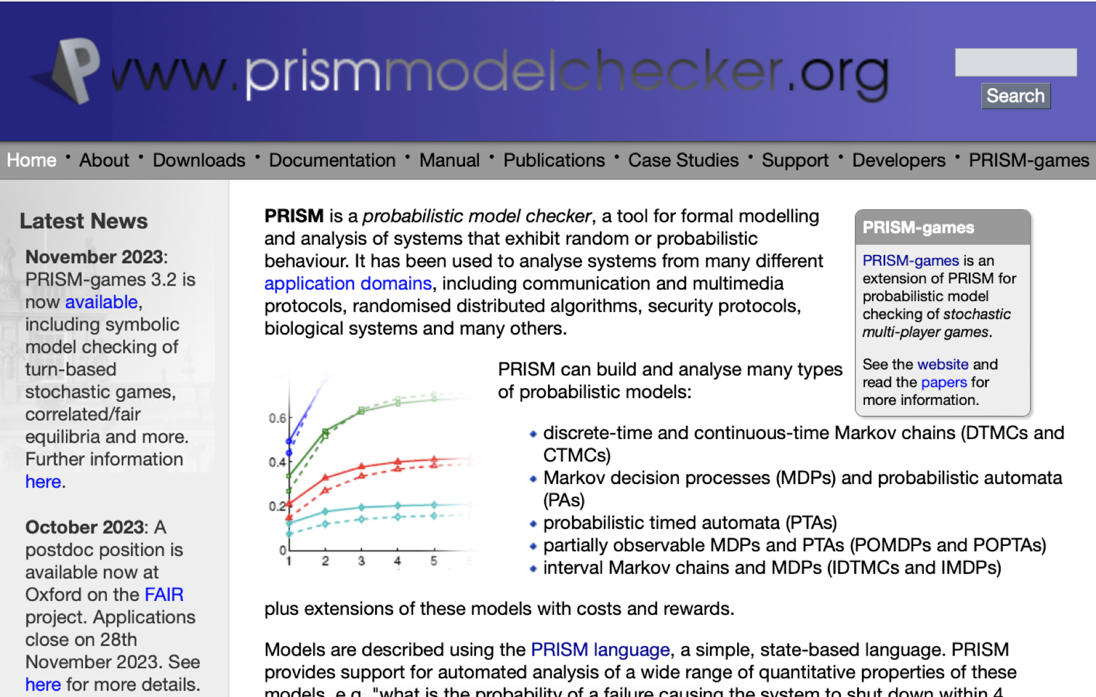
PRISM
(M. Kwiatkowska, G. Norman, D. Parker)
PRISM language for modelling concurrent systems
Based on a declarative version of CSP (with probabilities/rates)
https://www.prismmodelchecker.org/

Slide 5
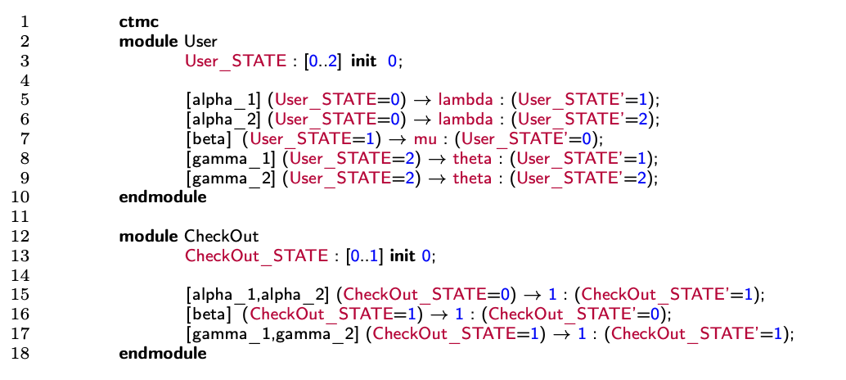
PRISM
Conditions
Labels
Rates
Updates

Slide 6

PRISM
Declarative approach
Very easy to add commands
Very hard to predict what their effect is on the system as a whole
There is a high risk of modelling something else than what was intended

Slide 7

Choreographies
Describe communication-based systems focusing on global flow of messages
Global viewpoint of an entire system
Entities have a common goal
No single point of control
Only focus on communications
Deadlock-free programs
Choreographies

Slide 8
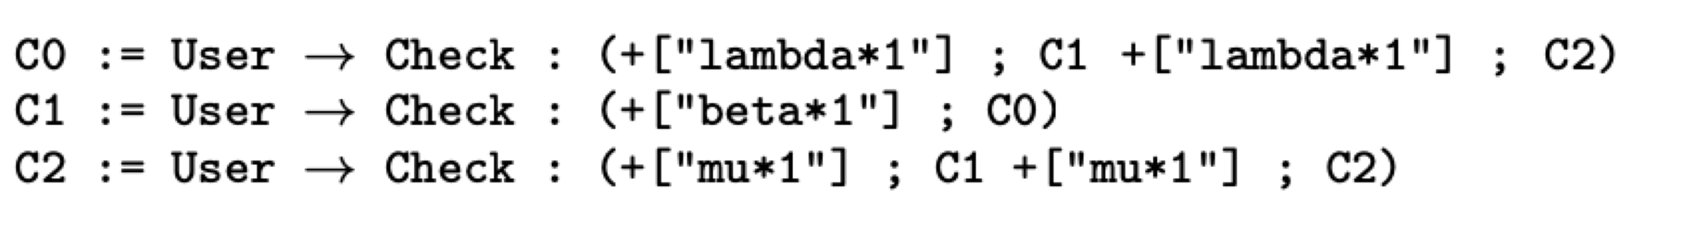
Choreographies
Processes interactions
Continuations
3 choreohgraphies

Slide 9
2
Choreographic Calculus
Syntax & Semantics

Slide 10
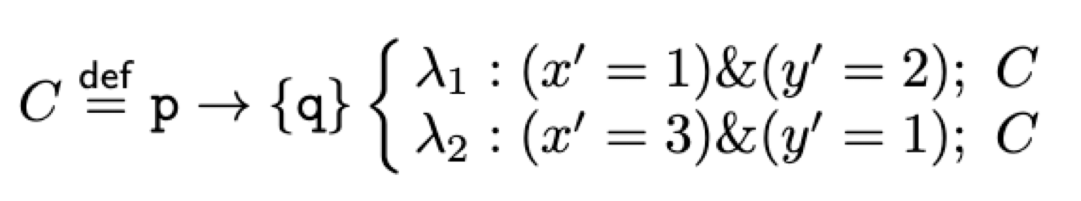
Syntax
Interaction
If-Then-Else
Recursion&End
Updates

Slide 11
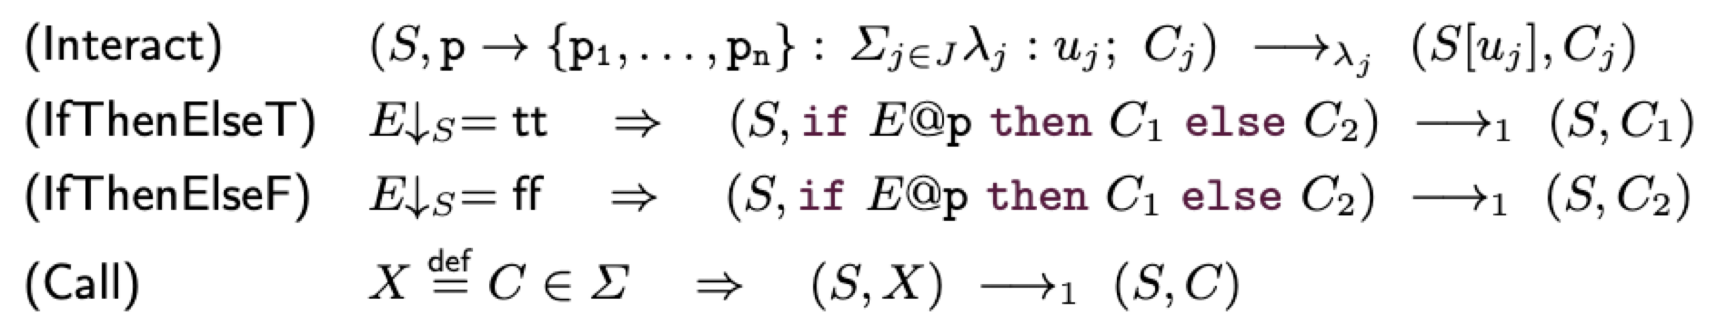
Semantics

Slide 12
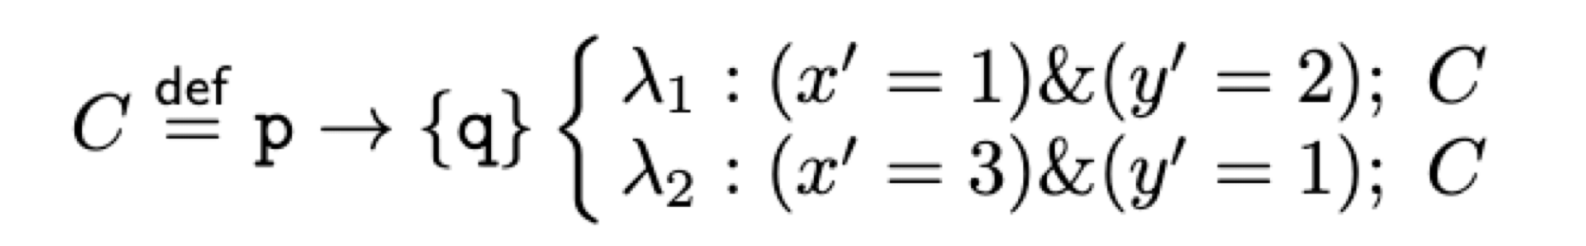
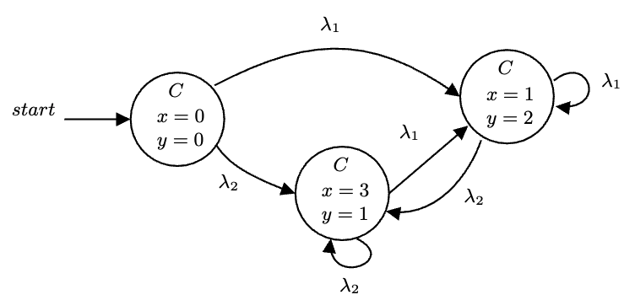
Example
Starting from the state in which S(x) = S(y) = 0 can be depicted:

Slide 13
PRISM Language
3
Syntax & Semantics

Slide 14
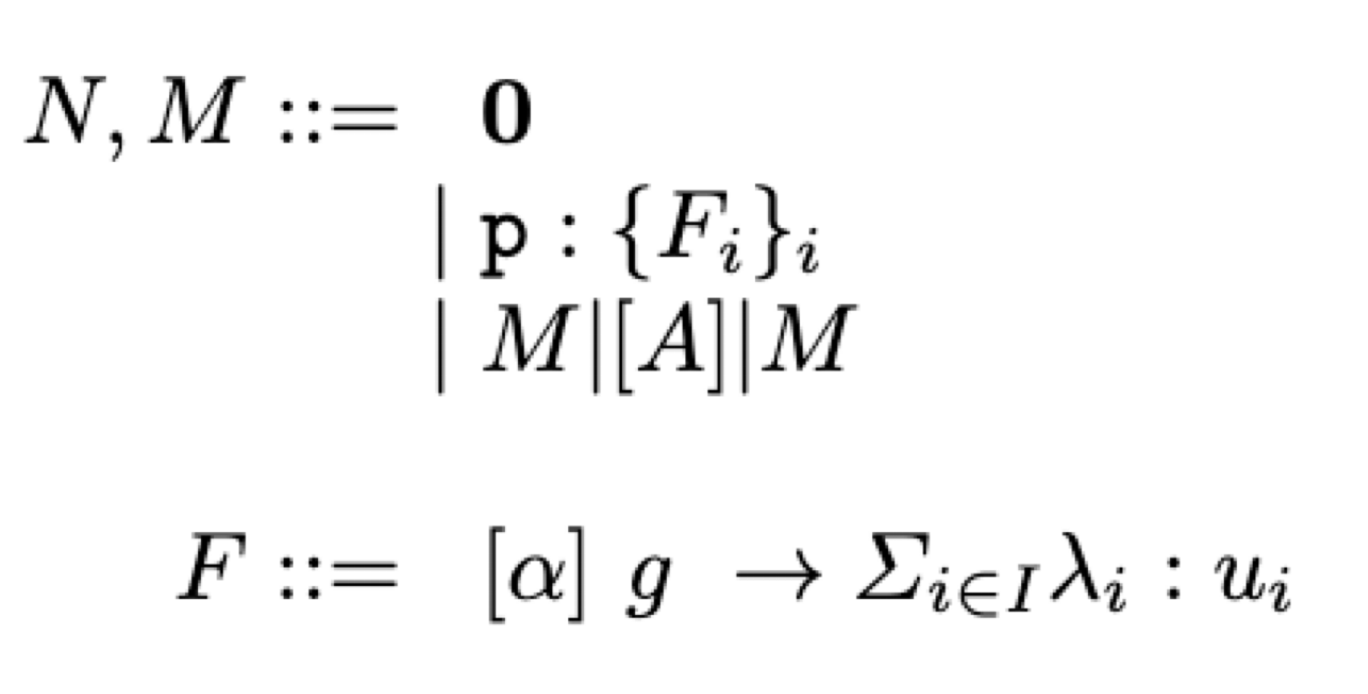
Syntax
Empty network
Networks
Module
Parallel composition
Commands

Slide 15
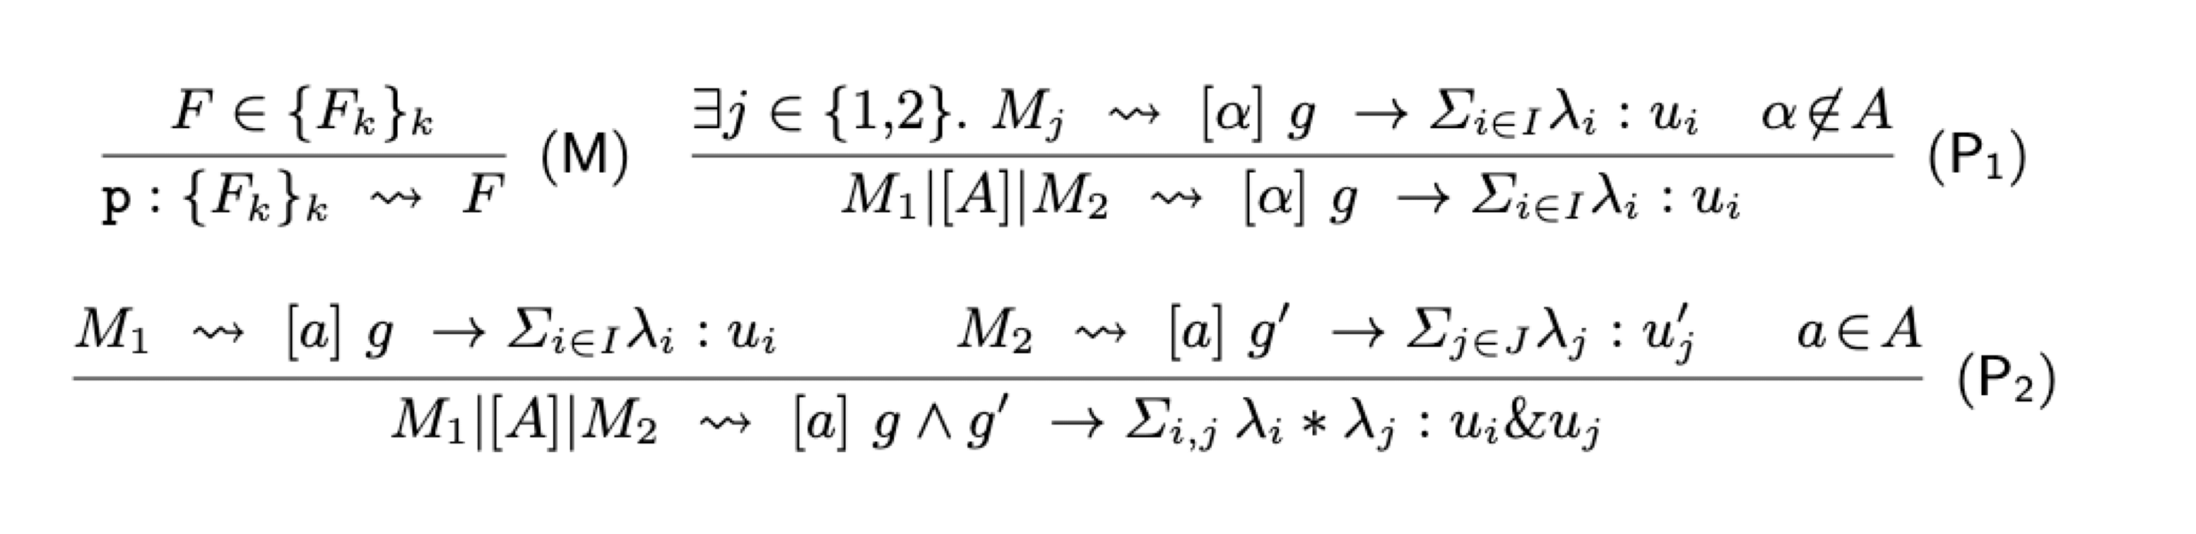
Semantics

Slide 16
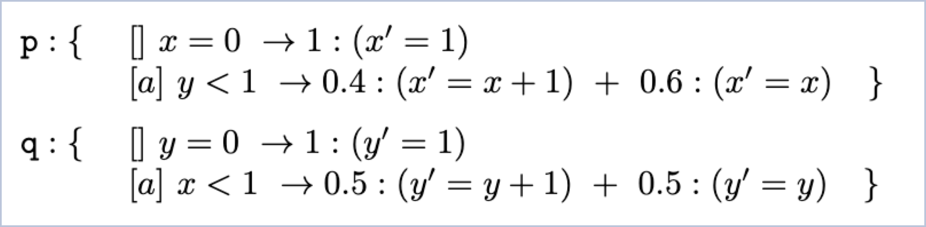
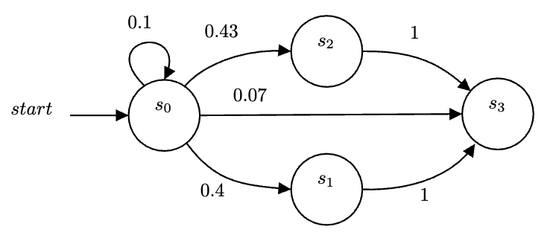
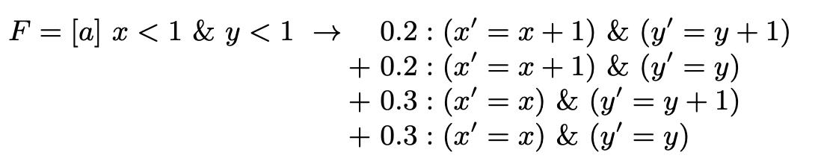
Example
Applying the semantics we can derive

Slide 17
4
Projection

Slide 18
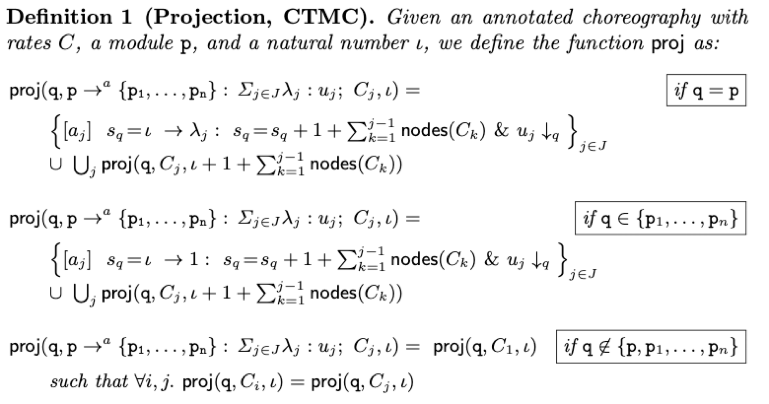
Projection: CTMC

Slide 19
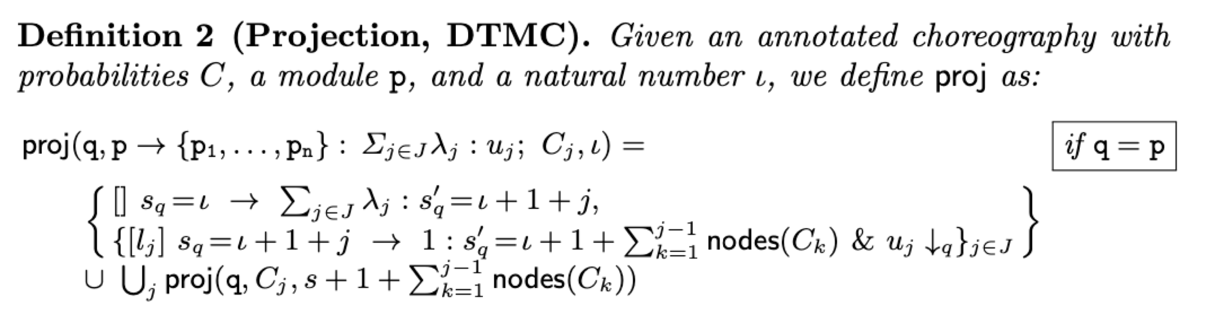
Projection: DTMC

Slide 20
Projection: Theorem
Our projection operations are correct with respect to the semantics of choreographies and PRISM

Slide 21
5
Implementation and Benchmarking

Slide 22
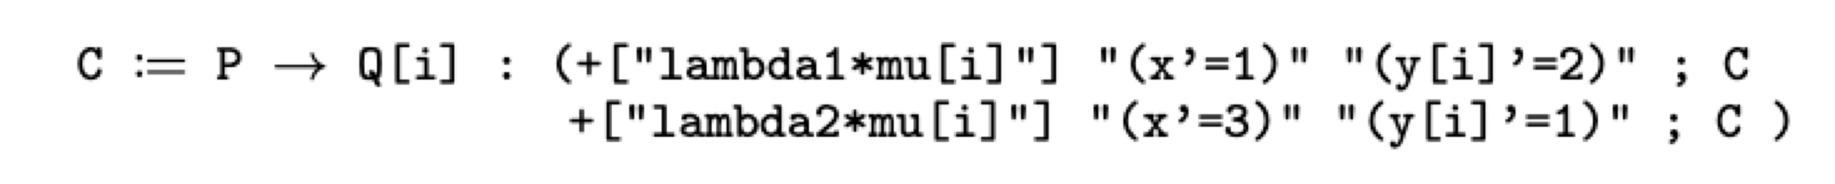
Implementation
In Java, ANTLR
Available at https://github.com/adeleveschetti/ChoreoPRISM
Generates PRISM code that needs to be fed to PRISM
Implementation offers extra language constructs
Parametric modules renaming

Slide 23
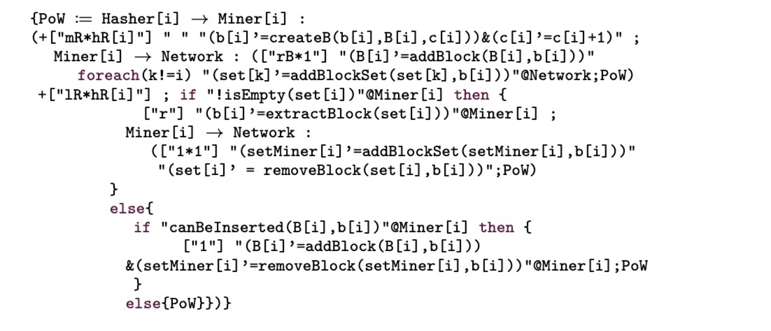
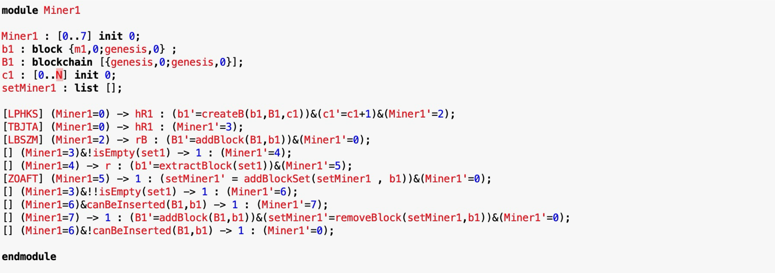
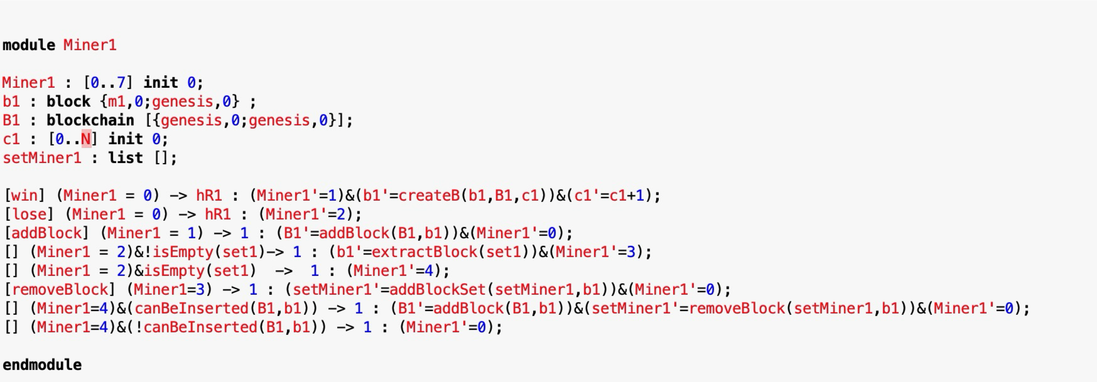

Bitcoin Protocol
Projected PRISM Model
Original PRISM Model
Choreographic Calculus

Slide 24
Bitcoin Protocol
Choreographic Calculus

Slide 25
Bitcoin Protocol
Projected PRISM Model

Slide 26
Conclusions
6

Slide 27
Conclusions
Probabilistic
Modeling concurrent probabilistic systems
Choreographic
Calculus
Expressive clarity
Formal Sematics
Implemented projection

Slide 28
Next Steps
1
Extend the language
2
Extend the theory
Generate Markov chains directly from choreographies
3
Can we directly generate Markov Chains?
Would this improve the performance drastically?

Slide 29
Thanks!
Do you have any questions?
Adele Veschetti
adele.veschetti@tu-darmstadt.de

